Slide 1
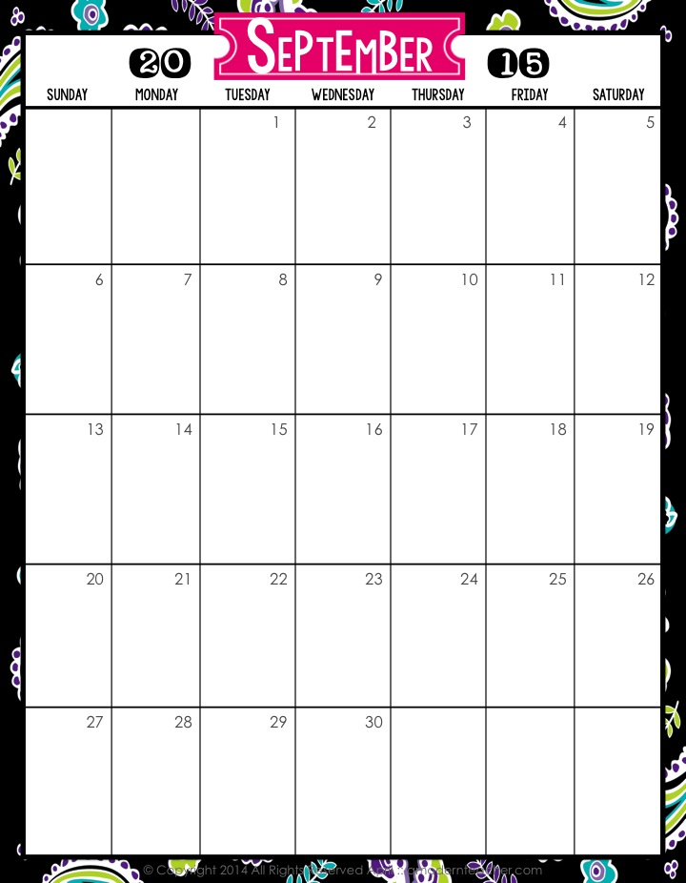
August 31st
^{Staff Inservice Day}
Professional Development Day
11 am Grades 2-4 Parent /Student Visitation
First Day of School
3:30 Staff Mtg.
2:20 Team Mtg.
ELA & Math Pretests
Labor Day
Begin ELA Module 1: Approx.35 days
Begin Math Module 1: 23 days
AIMSWEB Benchmark Testing Sept. 8-15
3:30 IL Mtg.
2:20 Team Mtg.
8:00 am
Grade level Mtg.
2:20 Team Mtg.
3:30
Curriculum
Council
AIMSWEB Benchmark Testing
2:20 Team Mtg.
Data Analysis Mtgs.
Elementary Open House

Slide 2
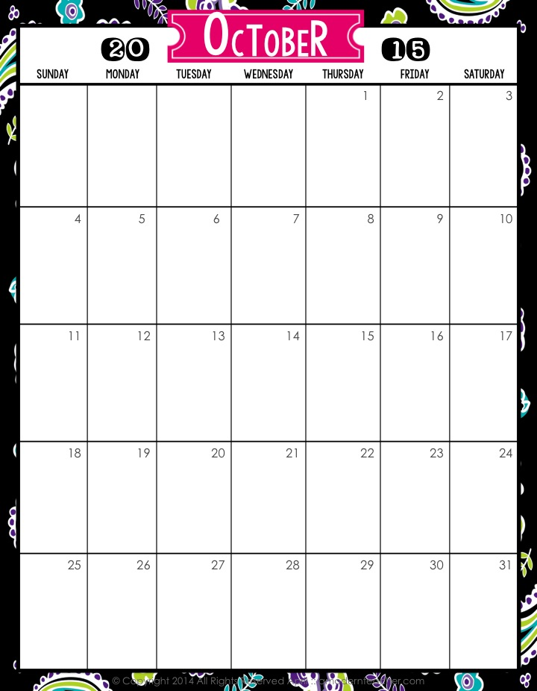
1st Word Work Grade
2:20 Team Mtg.
End of 5 weeks
Peter Rabbit Tales: Reg Lenna 11:00 am
2:20 Team Mtg.
3:30 Staff Mtg.
End Math Module 1
Begin Math Module 2 Approx. 20 Days
Columbus Day
3:30 IL Mtg.
2:20 Team Mtg.
8:00 am grade level mtg.
2:20 Team Mtg.
End ELA Module 1
Begin ELA Module 2A or 2B Approx. 40 Days
3:30 Curriculum Council
½ Day for Students
Interim Assessment Week: Quarter 1
Halloween

Slide 3
2:20 Team Mtg.
Daylight Savings Time Ends
End Math Module 2
Teacher Inservice Day
3:30 Staff Mtg.
End of First Quarter
2nd Word Work Grade
Begin Math Module Approx. 20 Days
Data Analysis Mtg.
Grades Due
3:30 Curriculum Council
2:20 Team Mtg.
Veteran’s Day
First Quarter Report Cards Go Home
8:00 am Grade level mtg.
2:20 Team Mtg.
Thanksgiving Break

Slide 4
2:20 Team Mtg.
3:30 Staff Mtg.
End Math Module 3
Happy B-Day Susan!
Begin Math Module 4
Approx. 16 days
On Stage for Youth
“Lightning Thief”
12:30
3rd Word Work Grade
2:20 Team Mtg.
3:30 Curriculum Council
3:30 IL Mtg.
End of 5 Weeks
8:00 am Grade level
2:20 Team Mtg.
End ELA Modules 2A & 2B
Happy B-Day Kim!
Winter Break!
Winter Break

Slide 5
Winter Break
Begin ELA Module 3A or 3B
Approx. 40 days
School Resumes
3:30 Staff Mtg.
2:20 Team Mtg.
Happy B-Day Erin!
Begin Math Module 5 Approx. 28 Days
3:30 Curriculum Council
3:30 IL Mtg.
2:20 Team Mtg.
Aimsweb Benchmark Testing/Interim Assessments Second Quarter
8:00 am Grade level Mtg.
Happy B-Day Chris!
MLK Day
2:20 Team Mtg.
4th Word Work Grade
Data Analysis Mtg.
2:20 Team Mtg.
End of 2nd Quarter

Slide 6
Teacher Inservice Day
2:20 Team Mtg.
2nd quarter Grades Due
3:30 Staff Mtg.
2nd quarter Report Cards Go Home
3:30 IL Mtg.
2:20 Team Mtg.
Valentine’s Day
President’s Day
8:00 am Grade Level Mtg.
Mid-Winter Break
2:20 Team Mtg.
End Math Module 5
Begin Math Module 6 Approx.

Slide 7
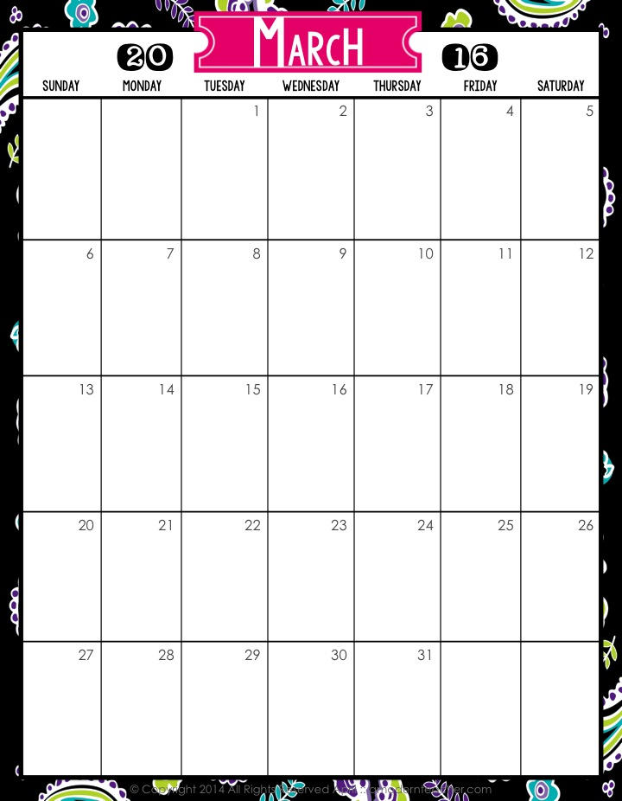
5th Word Work Grade
2:20 Team Mtg.
End ELA Module 3A
& 3B
3:30 Staff Mtg.
End of 5 Weeks
Half Day
Begin ELA Module 4 Approx. 40 days
3:30 Curriculum Council
2:20 Team Mtg.
Begin Grade 3 & 4 Interim Assessments
End Math Module 6
3:30 IL Mtg.
8:00am Grade Level Mtg.
Begin Math Module 7 Approx. 40 days
Daylight Savings Time Begins
2:20 Team Mtg.
Spring Break!!!!
Easter
Day Off
Finish Grade 3 & 4 Interim Assessments

Slide 8
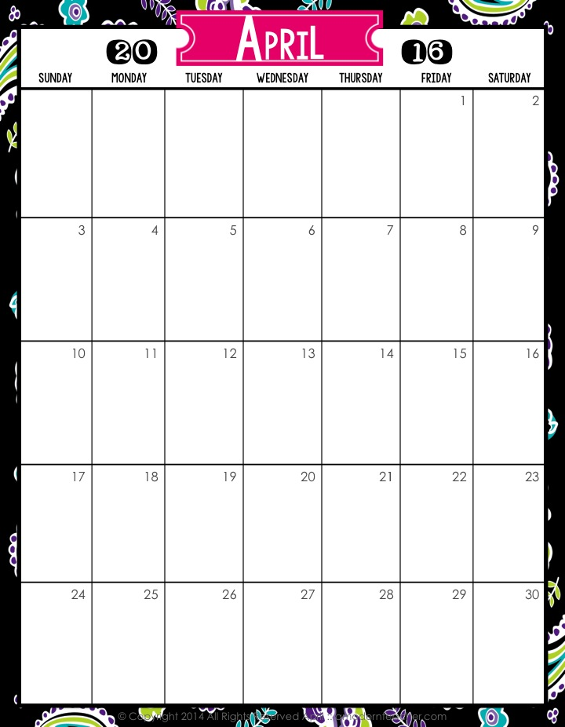
2:20 Team Mtg.
3:30 Staff Mtg.
NYS ELA Assessments
2:20 Team Mtg.
6th Word Work Grade
2:20 Team Mtg.
3:30 IL Mtg.
End of 3rd Quarter
NYS Math Assessments
8:00 am. Grade Level Mtg.
Teacher Inservice Day
All data entered from Interims
Happy B-Day Jill!
2:20 Team Mtg.
Grades Due
Data Analysis Mtgs.
Report Cards Go Home
2:20 Team Mtg.

Slide 9
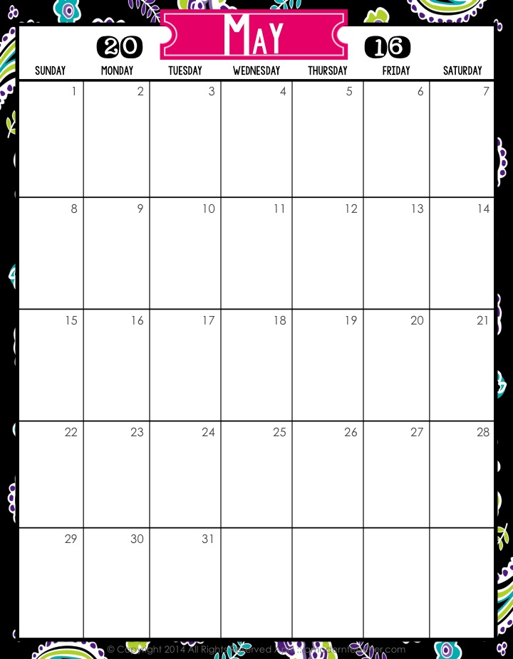
3:30 Staff Mtg.
2:20 Team Mtg.
Happy B-Day Catherine!!
Mother’s Day!
3:30 Curriculum Council
3:30 IL Mtg.
2:20 Team Mtg.
8:00 am Grade Level Mtg.
7th Word Work Grade
2:20 Team Mtg.
End of 5 Weeks
2:20 Team Mtg.
Memorial Day

Slide 10
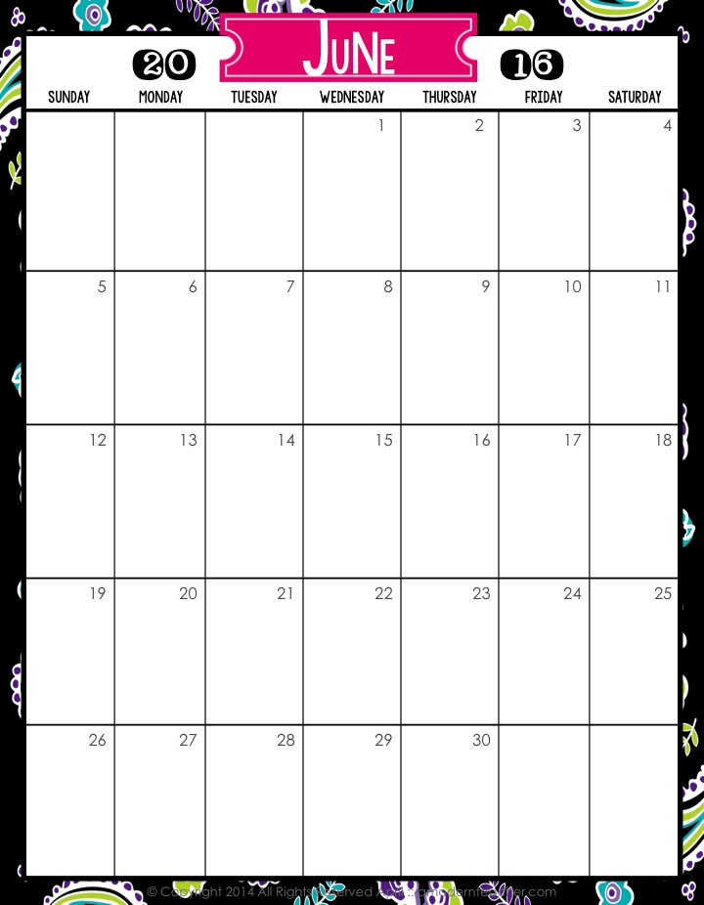
3:30 Staff Mtg.
2:20 Team Mtg.
8th Word Work Grade
2:20 Team Mtg.
Interim Assessments Quarter 4
3:30 IL Mtg.
Happy B-Day Val!
8:00am Grade Level Mtg.
3:30 Curriculum Council
2:20 Team Mtg.
Last Day!!
Father’s Day
Data Analysis Mtgs.

